Slide 1
Research Data Management
In the Data Lifecycle

Slide 2

Julie Goldman
Jacqueline Cellini
Reference and Education Librarian
Jacqueline_Cellini@hms.Harvard.edu
Meghan Kerr
Archivist and Records Manager
Meghan_Kerr@hms.harvard.edu
Heather Mumford
Archivist, Harvard T.H. Chan School of Public Health Heather_Mumford@hms.harvard.edu
Research Data Services Librarian Countway Library of Medicine #242 Julie_Goldman@hms.harvard.edu

Slide 3

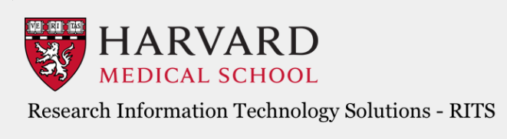


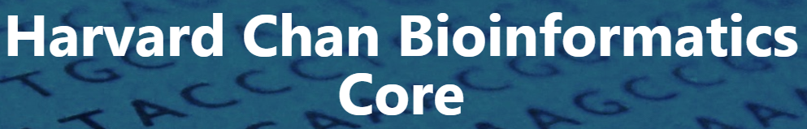
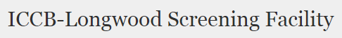

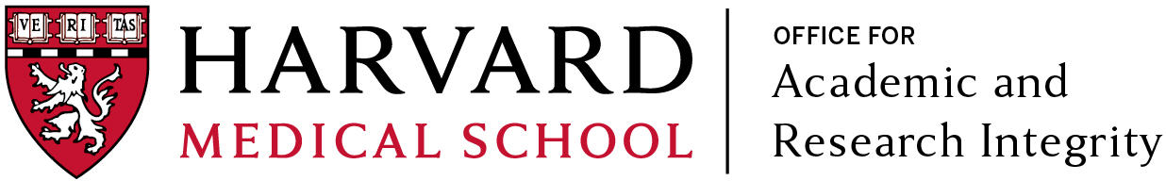




Slide 4
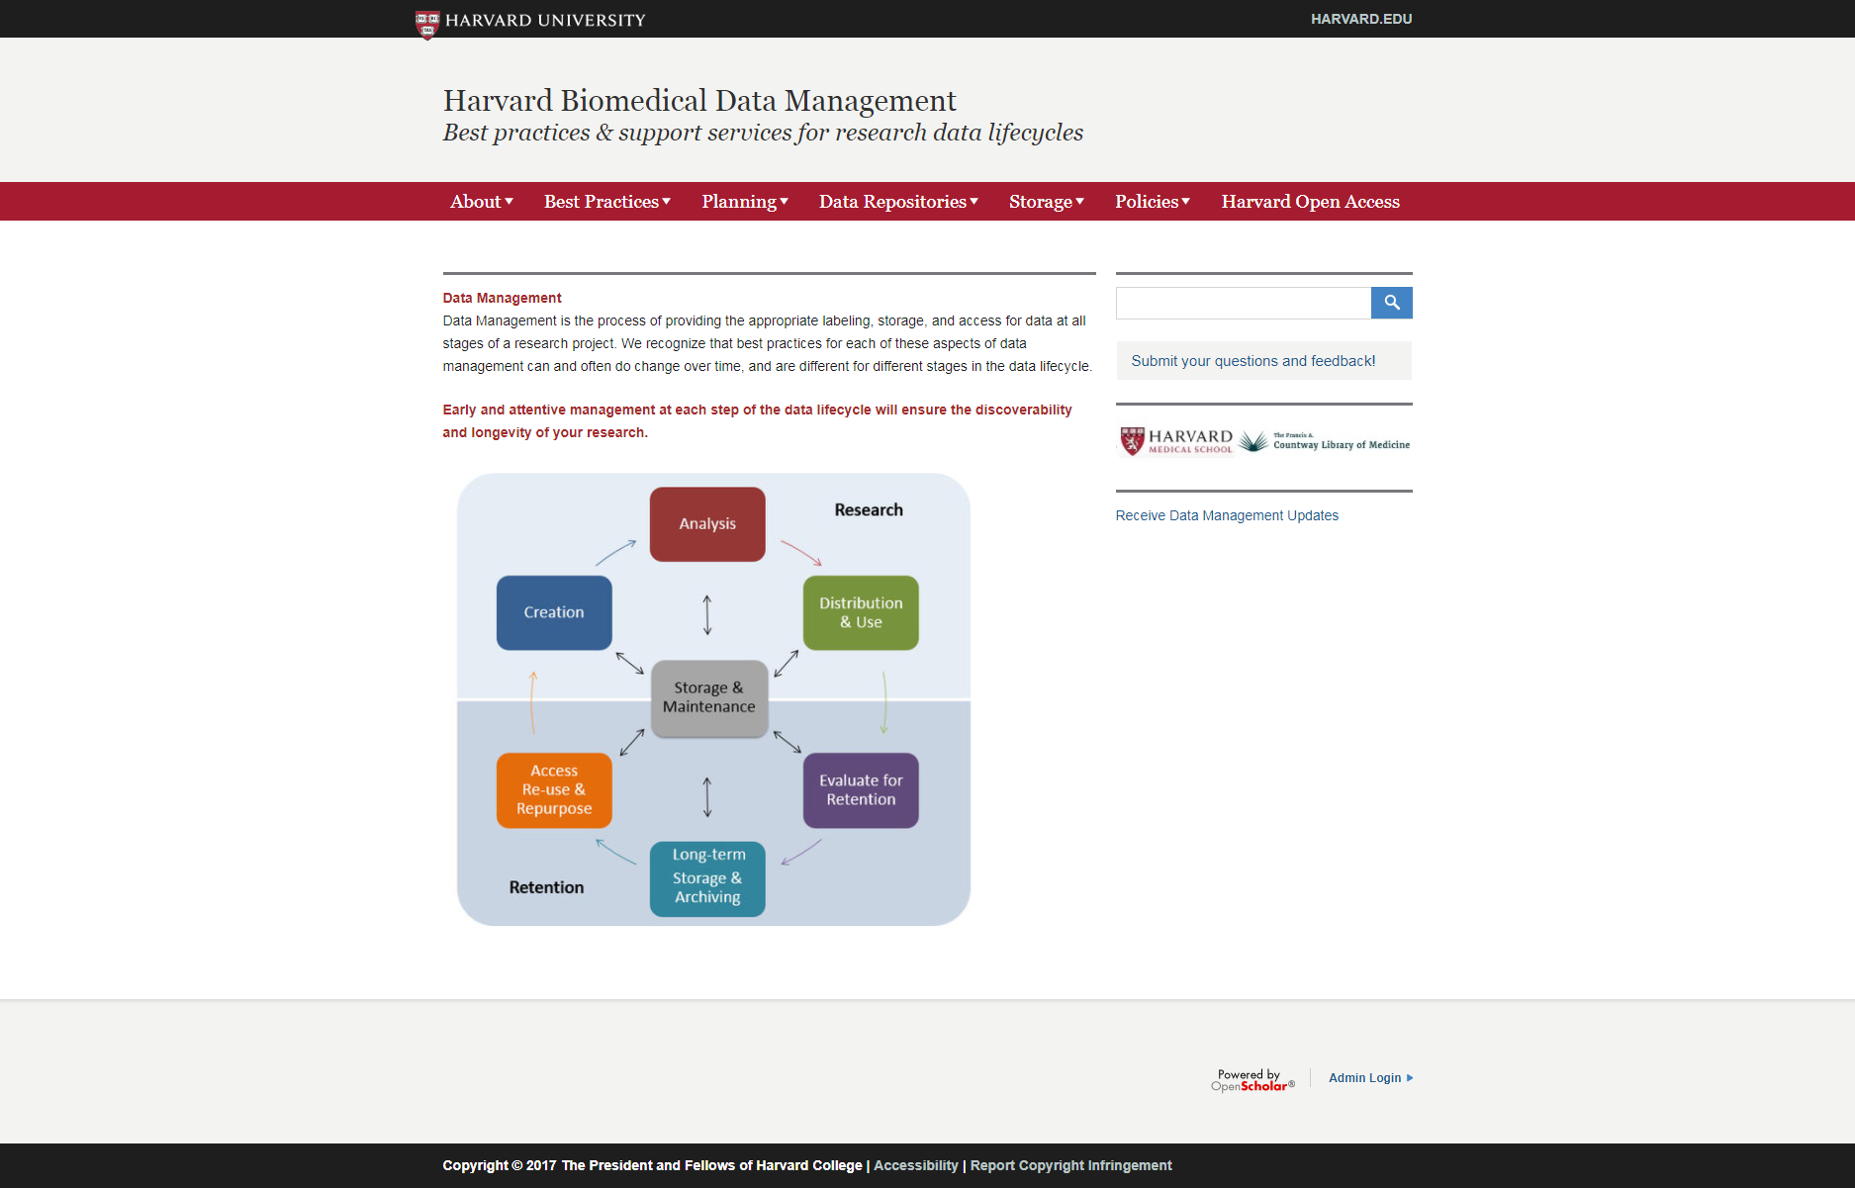
http://datamanagement.hms.harvard.edu

Slide 5
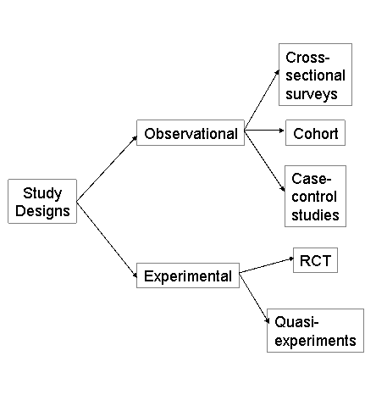
Data Lifecycle for Biomedical Data
Analysis
Distribution & Use
Long Term Storage & Archiving
Access Re-use & Repurpose
Creation
Evaluate for Retention
Storage & Maintenance
Notes:
Study design and the implementation of a study mean that data of some kid or another will be involved.
Research data management should be incorporated in the development of your study from the very beginning.
For most of you though, this won’t be the case until you design your own studies. Most of you now will be coming into studies that are already ongoing.
An important thing to remember when you come into those studies and when you take a look at this checklist, is that the RDM process won’t be a linear process.
What kind of research are you doing now and where might you be in this lifecycle?
There are four broad types of research data (University of Edinburgh):
Observational: data captured in real time, usually irreplaceable. (Examples include sensor readings, telescope images, sample data)
Experimental: data from lab equipment, often reproducible but can be expensive. (Examples include gene sequences, chromatograms)
Simulation: data generated from test models where models and metadata are more important than output data (examples include climate models)
Derived or compiled data is reproducible but expensive. (Examples include data mining, compiled databases, 3D models)

Slide 6
Why Manage Data
Data managed well can be more easily stored, discovered, shared, accessed, interpreted, and reviewed.
Notes:
There is movement among sponsors at the federal level to require the datasets that underlie research funded by the public be made available for scrutiny by the scientific community and the public.
Managed data will be more accessible and comprehensible by you and others. It will be discoverable, sharable and it will take minimal effort to work with. In other words- you can focus on the research and the science instead of spending time trying to decipher your file names and locations – or someone else’s
You think you will remember the arcane system you had of naming files but next week or next year, it will have slipped your mind.
Managing your data is common sense organization across a project and/ or a team that allows for accurate communication about that project. You can trace every change and outcome.
This is necessary for study reproduction and integrity and it is helpful when you are just coming into a project.
How many of you have designed a study from the ground up?
How many of you have come into the middle of a study – how long did it take you to identify the workflow, security measures…and adapt to them?
How many would be able to locate most of the information on this checklist on the study you are working on?
Have you heard of an Orcid ID? Do you have one?
Do you know the difference between managing your data and managing your records?
Why should you be concerned with managing your data?
1. Enable continuity of research projects
- Easier for data producer, PI, and collaborators to find data.
- If you revisit the data in six months, will you be able to remember all of the details? the parameters? Test runs vs actual experiment.
2. Facilitate data sharing and re-use
- Increases visibility of research.
3. Reduce research and data storage costs
- Minimize storage of duplicate files, increase ability to re-use data.
4. Promote data reproducibility
- Well-documented reagents, protocols, & datasets are available.
- Granting agencies and journals are increasingly requiring this documentation, including formalized data management plans.

Slide 7
Data Management Plan
A data management plan (DMP) is a written document that describes the data you expect to acquire or generate during the course of a research project, how you will manage, describe, analyze, and store those data, and what mechanisms you will use at the end of your project to share and preserve your data.
Notes:
Data management plans (DMPs) are an important element in any grant proposal, and are based on a careful analysis of several areas:
1. The data to be collected, e.g. what data are necessary to answer the research questions, and what standardized validated instruments may be implemented;
2. Who will be providing the data, e.g. interviewers, participant self-reports, medical record review, laboratory data via electronic transfers, etc.;
3. How the data will be collected: direct entry into laptops or other mobile devices is preferred, but sometimes data must be collected on paper, and implementing procedures to ensure quality collection of data is of great importance;
4. What software platform best meets the study’s data collection and management needs;
5. What quality control features must be in place to ensure prompt and accurate collection of quality data for analysis and for the smooth execution of the research study,
6. How data will be shared both during the study and after its final analyses are complete; and
7. Plans for final archiving of the study
Writing a DMP helps you formalize this process, identify weaknesses in your plan, and provide you with a record of what you intend(ed) to do.
Data management is best addressed in the early stages of a research project, but it is never too late to develop a data management plan.

Slide 8
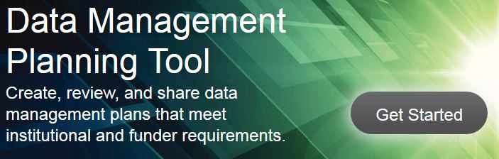
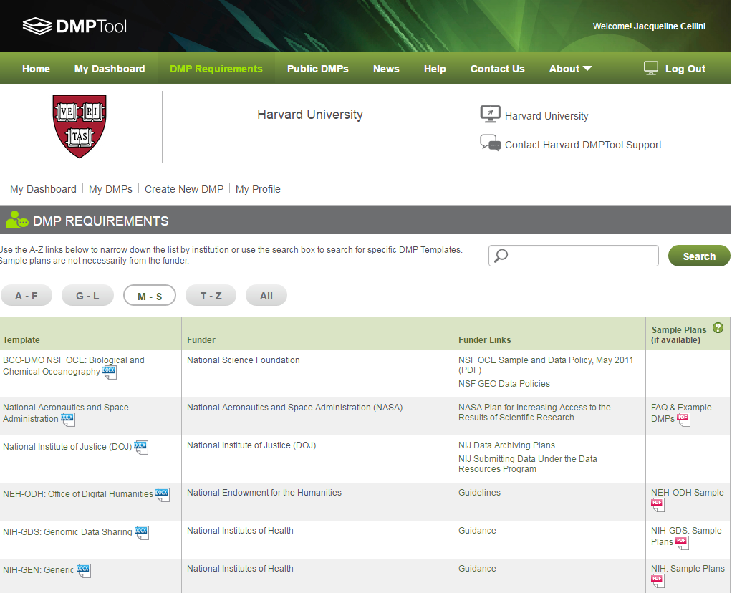
DMPTool
The DMPTool is an online tool that includes data management plan templates for many of the large funding agencies that require them.
Harvard is an affiliated partner institution. You can log in as a user from your institution with your HarvardKey. By being affiliated Harvard, you will be presented with institution-specific guidance to help you complete your plan.
Notes:
DMPTool is a service of the University of California Curation Center of the California Digital Library
Harvard is an affiliated partner institution - you can log in as a user from your institution with a HarvardKey.
By being affiliated with your institution, you will be presented with institution-specific guidance (displayed as resource links tab) to help you complete your plan.
The DMPTool is an online tool that includes data management plan templates for many of the large funding agencies that require these plans,
You can save and come back to your plan as often as you like. When you are finished, you can export your plan in plain text format and insert it into your grant proposal.

Slide 9
Storage affects the whole cycle
Analysis
Distribution & Use
Long Term Storage & Archiving
Access Re-use & Repurpose
Creation
Evaluate for Retention
Storage & Maintenance
Notes:
HMS has for many years provided advanced computational resources to both On-Quad and affiliate faculty at no direct cost to researchers.
Historically, the rate of data stored at HMS has doubled annually; it is therefore no longer sustainable for the School to wholly fund the demand for storage.
For On-Quad faculty it will only be necessary to include storage costs in grants
Thinking about storage in both the short-term and the long term is necessary- including the costs associated.
If you take away one thing from this information session then take away the idea that Storage for data must be considered in every single stage of the RDM lifecycle.
The only place that data and records storage can be relinquished to someone else to maintain is if your contributions have been selected for archiving.

Slide 10
Data & Metadata
Creation
✓ Raw data
✓ Working files
Raw data
What is being measured or observed? This is the data that is being generated during the research project.
Processed data
How can the raw data be made useful- able to be manipulated?
Analyzed data
What does the data tell us? Is it significant? How so?
Finalized/published data
How does the data support your research question?
Analysis
✓ Analytical methods
✓ Analysis results
Notes:
Data management is an iterative process, but we are going to start by looking at the creation stage
The general idea is always to describe:
what the data is
when the data was collected
where it was collected
how it was collected
notes about the data characteristics (including file formats/potential format conversions)
any pertinent notes about experimental conditions.
Other considerations:
Data type and format
Volume of data
Data collection methods (including software and hardware used)
Data set citations and descriptions
File naming, versioning & data organization
Quality assurance protocols
Note that for collaborative research projects, it’s important to come to some agreement among members of the project team that will help ensure consistent data documentation practices by all.
Consider, too, strategies you might use for version control; how will you keep track of which version of a file or document is the most current? Version control can be particularly challenging for collaborative projects in which several people may have access to, or even the ability to, change, a file. Often multiple people are collaborating and it can be difficult to establish provenance of versions. If each older version is not saved or if it is merged into new version, valuable data could be lost.
Clear documentation makes it easier to interpret your findings later, helps facilitate collaboration, sharing, and reuse, and can also help ensure successful long-term preservation of your research findings.
Document your analysis procedures including:
Any data modifications
Any code used to run the analysis
Any models used
All hardware and software specifications

Slide 11
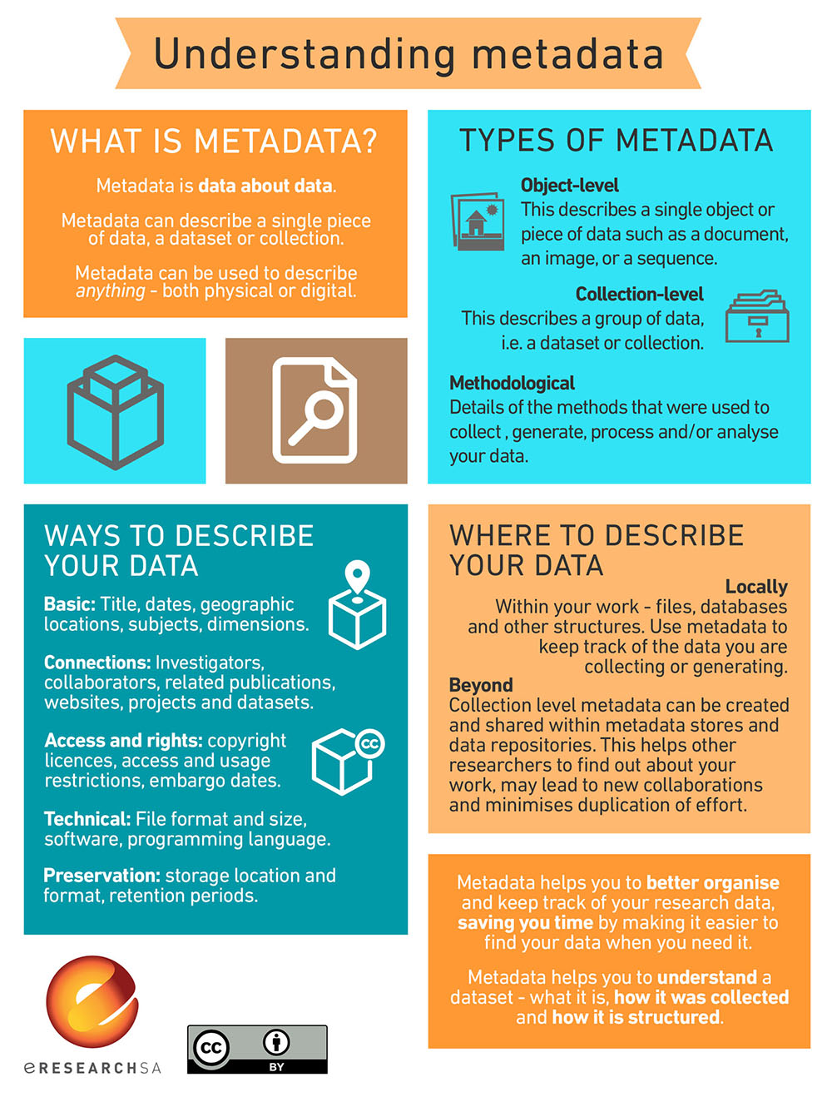
“Good metadata is standardized, consistent and interoperable, and facilitates discovery, preservation and archiving of data.”
https://www.ersa.edu.au/understanding-metadata
Notes:
More on metadata…
Throughout the data lifecycle, it is important to consider the metadata that you need to capture
Metadata includes information on investigation design such as sampling, methods of data collection, and time series and geographic range used. Any information on confidentiality and access restrictions to the project data would also be part of this study-level documentation. Think about your manual of operations and standards and procedure protocols developed with your study design.
And when you consider storage – you must consider metadata. Metadata, is often defined as data about data or as structured information that describes, explains, locates, and otherwise represents something else. Metadata, which is preserved along side the data makes it possible to retrieve, use or manage an information resource.
Metadata is necessary for resource discovery, organization of electronic resources, interoperability across systems, digital identification of data and archiving and preserving data.
Metadata comes in three forms. Descriptive, administrative and structural.
Metadata allows data to be found and interpreted. At a minimum, one needs to know who created the data, when the data were created or published, and a title or descriptive name used to refer to the dataset. Digital data should also have a unique and persistent identifier. Two metadata standards commonly used to describe research data are Dublin Core and the Data Documentation Initiative. These are not customized to biomedical research but there is more detail again on the http://datamanagement.hms.harvard.edu/ website.
The metadata guides for particular biomedical fields are still being developed and this is by no means standardized yet.
Good metadata is standardized, consistent and interoperable, and facilitates discovery, preservation and archiving of data.

Slide 12
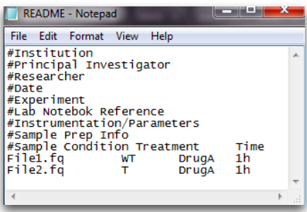
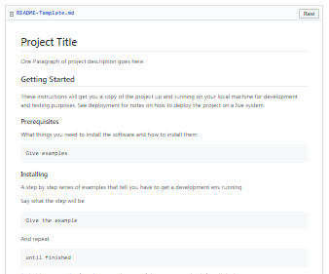
README File
To document changes to files or file names within a folder
To explain file naming conventions for future reference
To specifically accompany files/data being deposited in a repository
Notes:
README files are used:
To document changes to files or file names within a folder
To explain file naming conventions for future reference
To specifically accompany files/data being deposited in a repository
How to Create a README File
Create a plain text file (.txt) using a text editor (e.g., Notepad, TextEdit, emacs, vi) and avoid proprietary formats (e.g., Microsoft Word)
Use this file to document information about the dataset including sample info, naming conventions, abbreviations, codes, etc.
Use comments (#) to describe information type
Have a ReadMe file for each distinct dataset
Create in text editor (Notepad, TextEdit, vi, emacs, nano)
Start metadata information with comment (hashtag)
Save as tab-delimited .txt file (usually README.txt)

Slide 13

File Naming
Example files with no naming conventions:
Test data 2016.xlsx
Final FINAL! last version.docx
Example files with naming conventions:
20160104_ProjectA_Ex1Test1_SmithE_v1.xlsx
20160104_ProjectA_MeetingNotes_SmithE_v.1.docx
http://phdcomics.com/comics/archive.php?comicid=1531
Notes:
Find suggestions for Best Practices in File Naming Conventions on the Data Management website under the Best Practices tab
Should be descriptive and provide contextual information
Should be documented so that others in your lab or department can follow this standard
Establish a naming convention and use it consistently.
Consider including a combination of the following information:
Project or experiment name or acronym
Lab name/location
Researcher name/initials
Date or date range of experiment
Reference to lab notebook record
Type of data
Experiment conditions
Version number of file
DOs
Dates: YYYYMMDD (e.g., 20160907)
Times: use 24-hour military time to avoid confusion over a.m./p.m. (e.g., 1623 for 4:23 pm)
Sequential numbering: use leading zeros (e.g., 001, 002, … 010, 011, … 100, 101, etc.)
Names: surname then given (e.g., Smith_Bob)
Versioning: use numbers to indicate updated versions (v1, v2)
DON’Ts
Avoid special characters, such as ~ ! @ # $ % ^ & * ( ) ` ; : < > ? . , [ ] { } ’ ” |
Do not use carriage returns.
Future-proof files: may need to be ported to a Linux/HPC environment later
Special characters are often used for specific tasks in different operation systems.
Commas are problematic when using comma separated values (csv) file format.
Do not use spaces. Instead, try:
Underscores (e.g., file_name.xxx)
Dashes (e.g., file-name.xxx)
No separation (e.g., filename.xxx)
Camel case* (e.g., FileName.xxx)
*Some operating systems are case sensitive
Some software will not recognize file names with spaces.
File names with spaces must be enclosed in quotes when using the command line.

Slide 14
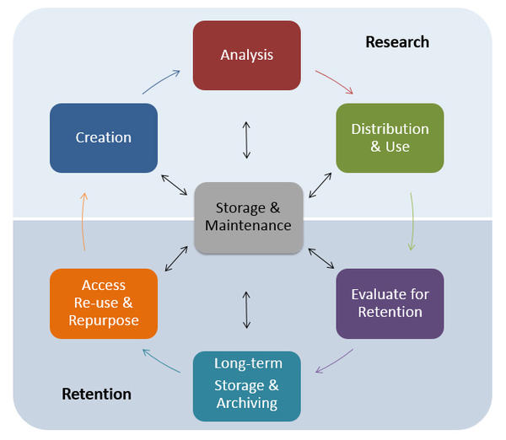
Storage
Storage & Maintenance
✓ Store on appropriate tier, with proper security
✓ Store locally on servers
or in the cloud
✓ Plan to maintain system
Storage, backup, and security are interrelated
Notes:
MEGHAN
What was the one thing considered at each stage of the data lifecycle?
Personal Computers and Laptops
Network Storage
External Storage Devices
Remote Storage Services (i.e. The Cloud)
-Need to think about security
-HMS has DropBox for Business
Physical Storage
Just as you would name any digital data files according to a standard naming convention, labeling is critical for physical storage of data. Any analog materials, from paper hardcopies of survey data to refrigerated lab specimens, should be appropriately labeled with the minimum metadata required to correctly identify the item. This could include creator, date created, associated project and project files, and ownership information.
During the early planning stages of a project, researchers must ensure coordination for these three elements.
For example, the choice of hardware for storage must be compatible with the subsequent choices for backup. Both primary and backup storage must have adequate security mechanisms in place. It is a continuum, from hard drives to automatic backup to encryption; the project planning and data management must account for all of it.
Storage
Data storage for even short-term projects should involve both media types, ensuring access to the data should media fail. Storage media should be updated regularly, between 2 and 5 years.
benefits and cautions to consider:
Personal Computers and Laptops
Personal computers and laptops make use of an internal hard drive to store all your data and system files. The internal hard drive is the most immediate storage option that you have. When your computer is functioning normally, you can quickly and reliably access the files on your hard drive. These are convenient for storing your data locally as you are working on it, but should not be the only storage system that you use. Local drives can fail or PCs and laptops may be lost or stolen leading to an inevitable loss of your data.
Network Storage
Network storage drives are standalone storage banks that are typically managed by IT staff centrally or within your School or College and accessed using LAN or internet connections. Centrally managed storage is subject to backup and security protocols that may be difficult or time consuming to implement individually. At the same time, centrally managed storage may have restrictions on access or file size that may impact your research. If you are working on a cross-institutional group generating terabytes of data, central storage may not be a good solution for you. It is worth investigating the central storage infrastructure and policies at your institution when considering your data storage needs.
External Storage Devices
An external hard drive sits outside of your computer and is connected via data cable. They store large amounts of data, and most allow you to schedule automatic backups of data. External hard drives have many benefits including storage of old files, backing up important data, convenience, storage for copying and transferring. It also provides security, both through encryption and the simple detachment of the drive.
Remote Storage Services (i.e. The Cloud)
Remote storage services provide users with an online system for storing and backing-up computer files. Mozy, A-Drive, Microsoft, and Amazon, to name a few, enable users to access data from anywhere with an Internet connection. Using banks of servers located around the globe, these services store and synchronize data files and offer redundant backup services for users. Remote storage solutions are extremely convenient and reasonably priced, but should not be the only storage solution in a data strategy. As third-party providers, a vendor’s terms of service should be examined, if the service is terminated, or other constraints on ethical data storage. For example, some data may be required to be stored within U.S. borders, depending upon institutional policies or guidelines for handling sensitive data. See the US Department of Commerce for more information on this issue. Review a cost comparison chart for major cloud services: http://cloud-services-review.toptenreviews.com/.
Commercial cloud storage and sharing services may have size, cost, or privacy limitations that could pose a risk to your data. Be sure to read the fine print and not rely on commercial options solely for storing your data. Commercial web applications can be discontinued unexpectedly, and you will want to know what happens to your data in that scenario. You want to know details about privacy and about how much storage you have, for how long, and for how much money.
Physical Storage
Just as you would name any digital data files according to a standard naming convention, labeling is critical for physical storage of data. Any analog materials, from paper hardcopies of survey data to refrigerated lab specimens, should be appropriately labeled with the minimum metadata required to correctly identify the item. This could include creator, date created, associated project and project files, and ownership information. See Module 3 for more information about descriptive metadata.
If moving, shipping, or storing analog materials, appropriate identification of any containers as well as the items within the containers will help to avert confusion if materials are misplaced or mishandled. Maintain a manifest of contents and label data down to the smallest discrete item. Use standard conventions for labeling items that are consistent between digital and analog data.

Slide 15
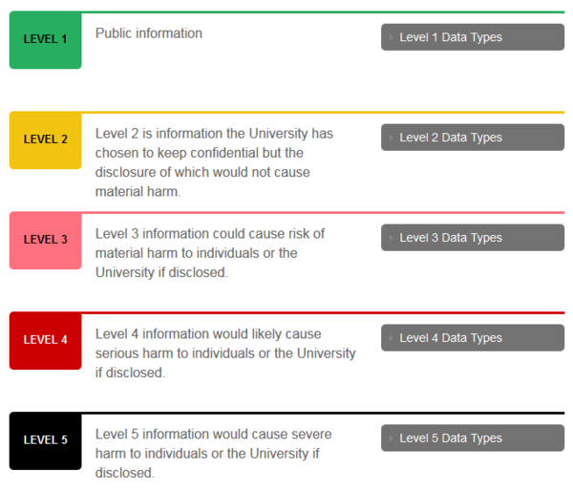
Security
Access
Limiting the availability of your data
Systems
Protecting your hardware and software
Data Integrity
Ensure that your data is not manipulated in an unauthorized way
Notes:
MEGHAN
https://vpr.harvard.edu/pages/research-data-security-and-management
https://policy.security.harvard.edu/view-data-security-level
Security
There are different levels of security to consider for your research data.
Protect access to your data
Unique User ID/Password
Unique user IDs ensure that activity can be traced to specific individuals. It is a way to authenticate and authorize access to a server and the data therein. A resource manager program uses unique user IDs for auditing and for checking authorization. User IDs and passwords are assigned to one person and one person only. Use a password manager or tool such as Msecure (https://msevensoftware.com/), Lastpass (https://lastpass.com), or KeePass (http://keepass.info)
Access through a centralized system
Centralized storage solutions are often more reliable than dispersed individual machines. Hard drives are the most burdened and hardworking parts of any computer or server, and therefore no hard drive will work forever. Centralized storage helps users overcome the consequences of damaged hard disks by saving data on several hard disk drives, (HDDs) in redundant arrays (RAID). They can provide backup services, physical and virtual security, environmental controls, restoration services, and scalability. https://hms.harvard.edu/departments/hms-information-technology/research-storage-funding-model/research-data-storage-services HMS offers Isilon , elastic cloud storage and long term storage options.
Role-based access rights
Role specific access levels to data can be assigned. A user account only grants limited privileges to data. Use this type of account for your daily work. An administrator account grants full privileges to make changes. If an unauthorized person gains access to your computer or if the computer is infected by a virus or suffers some other form of attack at the administrator level, then your computer is vulnerable to more damage.
Limitations of wireless devices to protect access
Mobile devices cannot be protected by the same means as hardwired devices. At present, tablets and smart phones lack the protection provided by antivirus programs and firewalls. The greatest hazard to tablets and smart phone security is loss or theft of the device itself. It is important to set a password for your device. Make sure a PIN is required to access your home screen. Run the latest version of your OS and be sure all patches are applied. Limit the amount of sensitive data you store on your device. Turn off Wi-Fi and Bluetooth if you are not using them. When you do use Wi-Fi, try to be sure you are on an encrypted network requiring a password.
Protect your computer systems
Updated anti-virus software
Virus protection software should be updated daily (this can usually be automated) and should be running in the background continuously. Antivirus software protects against malicious programs including viruses, worms, Trojans and other forms of malware.
Up-to-date versions of client software and media storage devices
All key software packages should be updated regularly including OS, browsers, productivity packages, etc. Up-to-date software works in concert with virus protection software and will limit your computers’ vulnerability. All applications that interact directly with the internet are especially vulnerable. Oftentimes these updates will be automated for you as part of an overall network plan if your computer or devices are supported by a centralized IT structure. Patching refers to a fix that is made available by the software creator or trusted 3rd party to correct vulnerabilities or exploits within that software. Some exploits (security holes in software or applications which can be used to gain unauthorized access to a system or network) are called zero day exploits. A zero day exploit is an attack that takes advantage of a security hole before the vulnerability is known. Patches should be applied immediately as time to infection through an exploit can happen very quickly.
Use of a firewall
The function of a firewall is to block unwanted network traffic from reaching your computer or server. By limiting network traffic that is not “allowed” you reduce the threat of malevolent intrusion. By limiting unwanted network traffic you limit the potential infections or malware. Firewalls can be both software-based and hardware-based. Windows, Linux, and Mac OS include software-based firewalls. The simplest form of hardware–based firewall is your typical home router.
Use of intrusion detection software to monitor access
While a firewall functions to block unwanted traffic while permitting legitimate communications, intrusion detection software detects and alerts administrators about intrusion attempts. It does not block these attempts. Whereas a firewall can be thought of as a security guard that stops unwanted traffic, intrusion detection software is more of a surveillance camera that show you an intrusion in progress.
Physical access
Security starts at the physical level. If possible confine your servers to climate controlled, locked rooms accessible by trusted staff and systems administrators. All consoles and dashboards should require authentication to be unlocked. Lock desktops and laptops. Locking lugs prevent theft of hard drives from desktops. Cable locks can secure laptops to furniture. Make sure that office doors are locked. You should be sure to lock your desktop when not in use.
Encryption
Encryption is coding information that cannot be read or deciphered unless someone has the decoding key. Encryption can be used for data in transit (being moved across the network) or data at rest in a storage medium. Excellent discussions of encryption including public and private key cryptography can be found at
http://searchsecurity.techtarget.com/tip/A-primer-on-encryption
http://en.wikipedia.org/wiki/Public-key_cryptography.

Slide 16
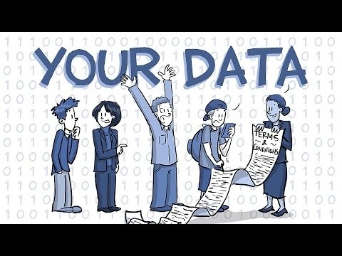
Ownership
Do you know who owns your data or the dataset you are using?
Notes:
Before you share your data, you have to know who owns it.
Who owns the data?
Data ownership can be very complex. HMS and Harvard institutional policies can help ascertain who owns data produced here and under what circumstances someone may take data, share data, or publish data. Data is seen as assets and therefore research stakeholders (institutions, funders, scientists, etc.) want to protect their intellectual property rights
and there are issues to be aware of such as licensing. Before starting a project you should have an idea of the ownership issues related to any resulting research products, including data.
Ownership of the data can also depend on who funds the research.
Federally funded grants
In most cases for federally funded research, the government gives the research institution the right to use data collected with public funds as an incentive to put research to use for the common good (the Bayh-Dole Act). Thus the research institution owns the data but allows the principal investigator on the grant to be the steward of the data. The PI may control the course, publication, and copyright of any research, subject to institutional review.
Graduate students, postdocs, or faculty involved in performing research on a particular grant would therefore be wrong to assume that they own the data that they are collecting. The PI takes responsibility for the collection, recording, storage, retention and disposal of data.
Data and lab notebooks collected by undergraduate and graduate students and research fellows for a research project belong to the grantee institution. Students should not take the data with them when they leave the institution unless they have made appropriate arrangements with the project PI.
Retaining copies of data might also be allowed, with permission.
When the PI faculty member leaves the grantee institution, they must negotiate with the institution to keep their grants and data. Many universities have offices and policies in place to ensure that such a transfer of data respects both the rights of the researcher and those of the institution(s). Our Records Management and Archiving contacts are available to talk to you if you are making a transition or unclear if you can take your data with you.
Research data is defined as the recorded factual material commonly accepted in the scientific community as necessary to validate research findings, but not any of the following: preliminary analyses, drafts of scientific papers, plans for future research, peer reviews, or communications with colleagues. This "recorded" material excludes physical objects (e.g., laboratory samples). Research data also do not include: (A) Trade secrets, commercial information, materials necessary to be held confidential by a researcher until they are published, or similar information which is protected under law; and (B) Personnel and medical information and similar information the disclosure of which would constitute a clearly unwarranted invasion of personal privacy, such as information that could be used to identify a particular person in a research study.
An important point to consider is that in the United States, while data and facts cannot be copyrighted, creative expressions of data, such as a chart or a table in a publication ARE copyrightable. In addition, be aware that in certain foreign jurisdictions such as the European Union, database compilations, including factual data, ARE protected by law.
Databases are generally protected by copyright law and are referred to as “compilations”. The U.S. Copyright Act defines a compilation as a “collection and assembling of preexisting materials or of data that are selected in such a way that the resulting work as a whole constitutes an original work of authorship.”
The individual facts or data contained within the database may or may not be protected by copyright; however, the selection and/or arrangement of the facts or data as a whole will be protected by copyright if it contains enough creative, original expression.
With only limited protection through copyright law, database developers generally protect their databases by using a legal contract, such as a license, so that users must comply with wishes of the copyright owner as to how that data may be accessed and used.
Facts and data are not copyrightable, but compiled databases and derived data can be. While creators of these types of work may seek exclusive rights, there is a less stringent copyright license that strikes a balance between "all rights reserved" language and terms that enable open access and reuse of data, e.g. a Creative Commons license (http://creativecommons.org).
Not all works are eligible for copyright protection: original works that are not fixed in a tangible format; titles, names, slogans; ideas, facts, data; lists of contents or ingredients; works in the public domain. However, trademark or patent laws may apply in some cases.
Creative Commons (CC)
Creative Commons licenses (http://creativecommons.org) are legal tools that data authors can assign to their data if they would like to allow the public to share and use their data while adhering to certain provisions. As noted in the Creative Commons site, "Creative Commons licenses let you easily change your copyright terms from the default of “all rights reserved” to “some rights reserved.” By easing some of the restrictive language of traditional copyright, Creative Commons licenses have facilitated open sharing and reuse of data. There are several types of Creative Commons licenses. The CC0 (Creative Commons Zero license) is strongly recommended for scientific data and has been widely adapted for releasing data into the public domain. In contrast to CC licenses that allow copyright holders to choose from a range of permissions while retaining their copyright, CC0 empowers yet another choice altogether– the choice to opt out of copyright and database protection, and the exclusive rights automatically granted to creators– the “no rights reserved” alternative.
Scientists who apply CC0 licenses to their databases agree to waive any copyright interests in the work and place them as completely as possible in the public domain, enabling others to freely build upon, enhance or reuse the works for any purposes without restriction.

Slide 17
Data Sharing
Distribution & Use
✓ Share data with collaborators
✓ Annotate datasets & upload to public repositories
✓ Include in relevant publications & reports
When establishing data sharing and access policies and provisions, consider whom you will share your data with, how it will be shared, and when in the research process you will share it.
Notes:
Overview of issues/obstacles related to reuse and sharing
Data sharing refers to the practice of making research data available to others for validation and replication of results.
Major national funding agencies such as the NSF, NEH, and NIH require all requests for funding contain a data management plan (DMP) addressing how the proposed project will comply with the agency's Data Sharing Policy.
In addition to meeting funder requirements, sharing data benefits the scientific community and society by providing more opportunities for collaboration, better science, and well-informed policy decisions --Making research data available within a data repository can increase the visibility of researched products and increase the impact of a project by encouraging secondary analysis of the data. Scholars have also found a significant association between publishing data and increased citation rates.
So what data sharing can achieve is the ability to answer a research question with the available data.
“Data or it didn’t happen” – Kristin Briney, Librarian
Data sharing:
Reinforces open scientific inquiry. Making data openly available decreases the potential for disagreements among researchers and allows scientific inquiry to progress unimpeded to the benefit of the entire research community.
Supports the verification and replication of original results. By making data available, data can be used to verify or replicate published results. Verification can bolster the original results or it can expose errors. Either outcome helps strengthen and protect the integrity of the scientific record.
Promotes new research and allows for the testing of new or alternative methods. While data creators may have one research question in mind, the same data may be reused to answer new and innovative research questions.
Encourages collaboration and multiple perspectives. Sharing data can begin conversations between researchers across disciplines. This could lead to cross-disciplinary collaborations or the exchange of knowledge across fields that could result in new innovative research approaches.
Provides important teaching resources. Data are extremely valuable pedagogical tools. Instructors may use data in analytical exercises or students may model their own work after high-quality data examples. Data can also provide students with firsthand experience in verifying results.
Reduces costs by avoiding duplicate data collection efforts. Avoiding unintended duplicate data collections saves both respondents and researchers valuable time and resources and freeze up researcher funds for other projects.
Protects against faulty or fraudulent data. Over the past few years, there have been multiple stories in the news about misconduct in research. Sharing data promotes transparency and accountability, which lessens the potential for purposeful falsification or distortion of data. It also allows reusers to detect unintentional errors. And finally, the expectation that others may be verifying data should encourage greater care in original analyses.
Enhances the visibility and overall impact of research projects.
Preserves data for future use. If a researcher makes their data available for sharing within a data repository, then they can be sure that the data will be available and understandable for the long-term for their own and others use.
Helps the broader community and individual researchers do better research. By sharing data, researchers support both their own research and the broader research community resulting in science that is more accurate, more open, more knowledgeable and has more resources at its disposal.

Slide 18
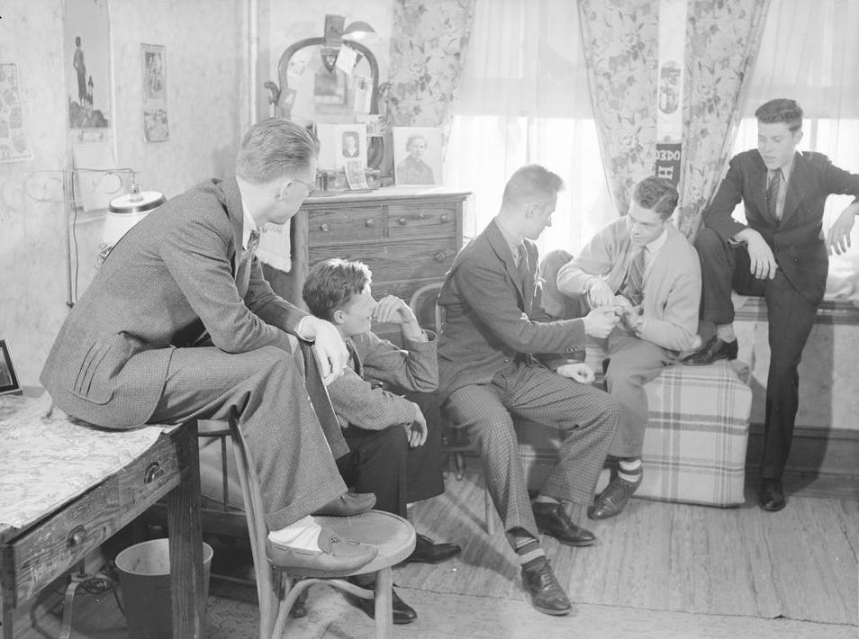
I won’t get a job in academia unless I publish in a high impact factor journal.
The cost will be prohibitive!
I’ll get scooped if I share my work openly.
I would but my advisor doesn’t want me to.
Publishing open access isn’t prestigious!
Image courtesy of Harvard Art Museums http://id.lib.harvard.edu/via/HUAM130253/catalog
Notes:
Data Sharing challenges
Obstacles that can effect researchers ability or willingness to share their data.
Takes time and effort to make data shareable.
Making data publicly available can be a labor intensive and time consuming process.
In a 2011 survey of researchers, over 50% sited insufficient time. And 40% sited lack of funding, as their reasons for not making data available.
There are perceived risks from loss of control of the data.
By sharing data, researchers may believe they're relinquishing control over their data. This can raise concerns that they may be scooped or another researcher could discover errors in their data, could reach contradictory conclusions using the data, or misuse the data.
Data contained confidential or sensitive information.
Data collected from human subjects may contain protected health information, or personally identifiable information, and researchers are responsible for protecting this sensitive data. In some cases, de-identifying data may be an option, but this can also be a labor intensive process. In other cases, removing certain identifiable information could negatively effect the usability of the data for secondary analysis.
The ownership of the data may be unclear or problematic. Researchers must also consider if they even have the right to share the data. In the case of collaborative projects, they will want to discuss the data with their partners. In some cases, for instance, if the data were proprietary or funded by private entities, researchers may not even be permitted to share the data due to intellectual property or copyright concerns.
There is a lack of incentives for sharing data. And last but not least, in many ways the current academic culture lacks the incentive structure to properly reward researchers who share their data.
Misconceptions:
Journal Impact Factor: importance of impact factors for career progression are sad but true; I argue we should stop relying on impact factor and citations and focus on many other measures for impact
Open Access / Prestige: publishing in @plosone was career suicide; Publishing in PLOS will hurt my reputation; I argue knowledge we create and manage needs to impact our communities; OA enables broad and rapid dissemination of research, informs the public, and expedites the scientific process in contrast to the reach of subscription content available to many of us in academia (limited to those institutions, mainly in developed countries, that can afford the subscriptions, which is becoming increasingly difficult); OA provides increased academic impact (articles receive more citations when research articles are freely available to be downloaded, read, and reused due to increased visibility, dissemination);
Scooped: if you put your stuff out there, make sure people have to/can cite it! pre-register your experiment! pre-registration does not stop anyone else from publishing the same experiment before you but it does allow you to demonstrate that you had thought of the idea before they published it
Cost: many institutions have a fund to help defray the cost of publishing in OA journals (check out Harvard OSC https://osc.hul.harvard.edu/authors); these are the costs you should include in your grant!

Slide 19
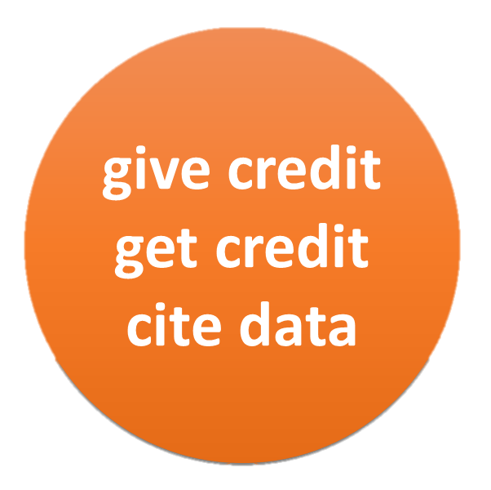
Citation & Attribution
Acknowledgement of the use of someone else’s information or work is a long-accepted practice in scholarly communication.
The following elements are generally considered the core elements of a data citation:
Author/Creator(s): creators of the data; can be one or more people or organizations
Title: title of the data set
Version: exact version or edition of the data set used
Publication Date: date when the data set was published or released
Publisher/Archive: data center or repository that is archiving and distributing the data
Identifier/Locator: URL or other linkable locator for the data; a persistent, permanent URL such as a DOI (Digital Object Identifier) or a handle is preferred
Notes:
Using data created by others
When making a request to use another’s data, be specific. Are you looking for an entire data set that includes multiple variables or are you looking for a subset of this data? Are you looking for data from a specific time frame, in a specific geographic area? Knowing and communicating to the data creator what the “boundaries” are of the data you want to access facilitates the sharing process.
Citation / Attribution of Data
Acknowledgement of the use of someone else’s information or work is a long-accepted practice in scholarly communication. This attribution is usually accomplished via a “citation”: when you publish a paper or do a presentation that makes use of someone else’s information, you include in that paper or presentation a reference to the work of that other person or group. It is important to cite not only the literature consulted but also the data files used, including your own. Plagiarism takes place when you use someone else’s data or words and do not acknowledge that you have done so.
Citing data files in publications based on those data serves several purposes:
Provides appropriate credit to the data producers and publishers
Enables other researchers to access the data for their own use or to replicate research findings
Assists in measuring the impact of a data set by tracking references to it in the scientific literature and in online conversations (“altmetrics”)
Helps data producers know how their data is being utilized
By providing a citation for your data, you make it easier for other users to identify and acknowledge it.
Data citation helps promote the reproduce-ability of research results, it allows us to track the usage and impact of data and it provides a structure by which we can recognize and reward data creators.
As a general rule of thumb you want to make sure you include enough information for another use to be able to locate the data set or the part of the database that you're referring to.
DataCite, an international standards body founded in 2009, recommends the following five minimum citation elements. A creator, a year of publication, a title, publisher, and identifier.
An identifier refers to any persistent ID which uniquely identifies the object, including a DOI or even a URL, though this may be less persistent.
If so, err on the side of caution, and always provide more information than less to help the users find the data. In the case of a dynamic database, that is continually updated, it may be near impossible to refer back to the exact version that you used. In such circumstances always include a date of download. In the life sciences it's common to include an accession number with the database name when you're referencing sequence data. You can see this in the examples on screen.
So what if you're using an unpublished data source?
Informal data sharing is relatively common. But even if the data are unpublished, the citation principles still applies. If somebody shared data with you, for example, via an email attachment, you can reference this as a private communication. Let's take a look at an example.
Good practice in data documentation and citation can contribute to reaching a better standard of reproducibility of research.
Data citation promotes the reproduction of research results, allows the impact and use of data to be tracked, and provides a structure which recognises and rewards the data creator.
Key take-away: By providing good documentation and a citation for your work, you make it easier for others to re-use your data, cite your work, and give you acknowledgement in the scholarly record. When re-using others' data you should give it a proper citation as well.
Data citation is evolving and there is currently no acknowledged standard on how to cite a dataset or construct a data citation. However, several organizations have developed their own practices, and international groups are creating formal guidelines for the scientific community.
The following elements are generally considered the core elements of a data citation:
Author/Creator(s): the creators of the data; can be one or more people or organizations
Title: the title of the data set
Version: the exact version or edition of the data set used
Publication Date: the date when the data set was published or released
Publisher/Archive: the data center or repository that is archiving and distributing the data
Identifier/Locator: URL or other linkable locator for the data; a persistent, permanent URL such as a DOI (Digital Object Identifier) or a handle is preferred

Slide 20
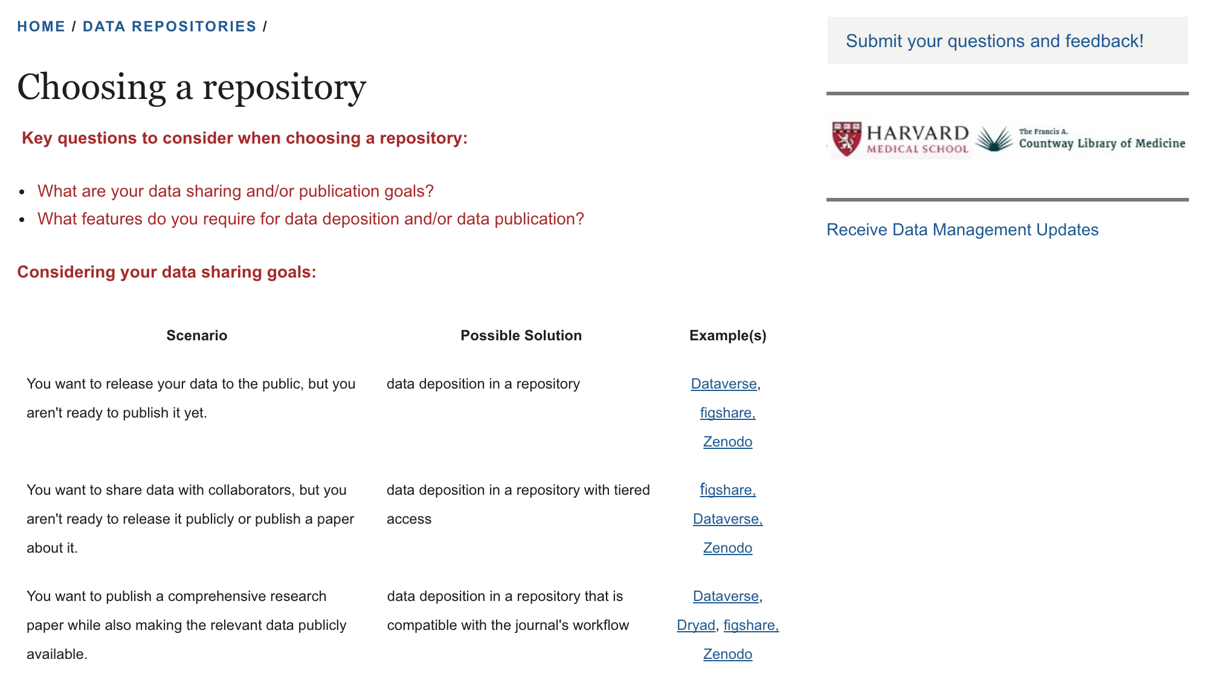
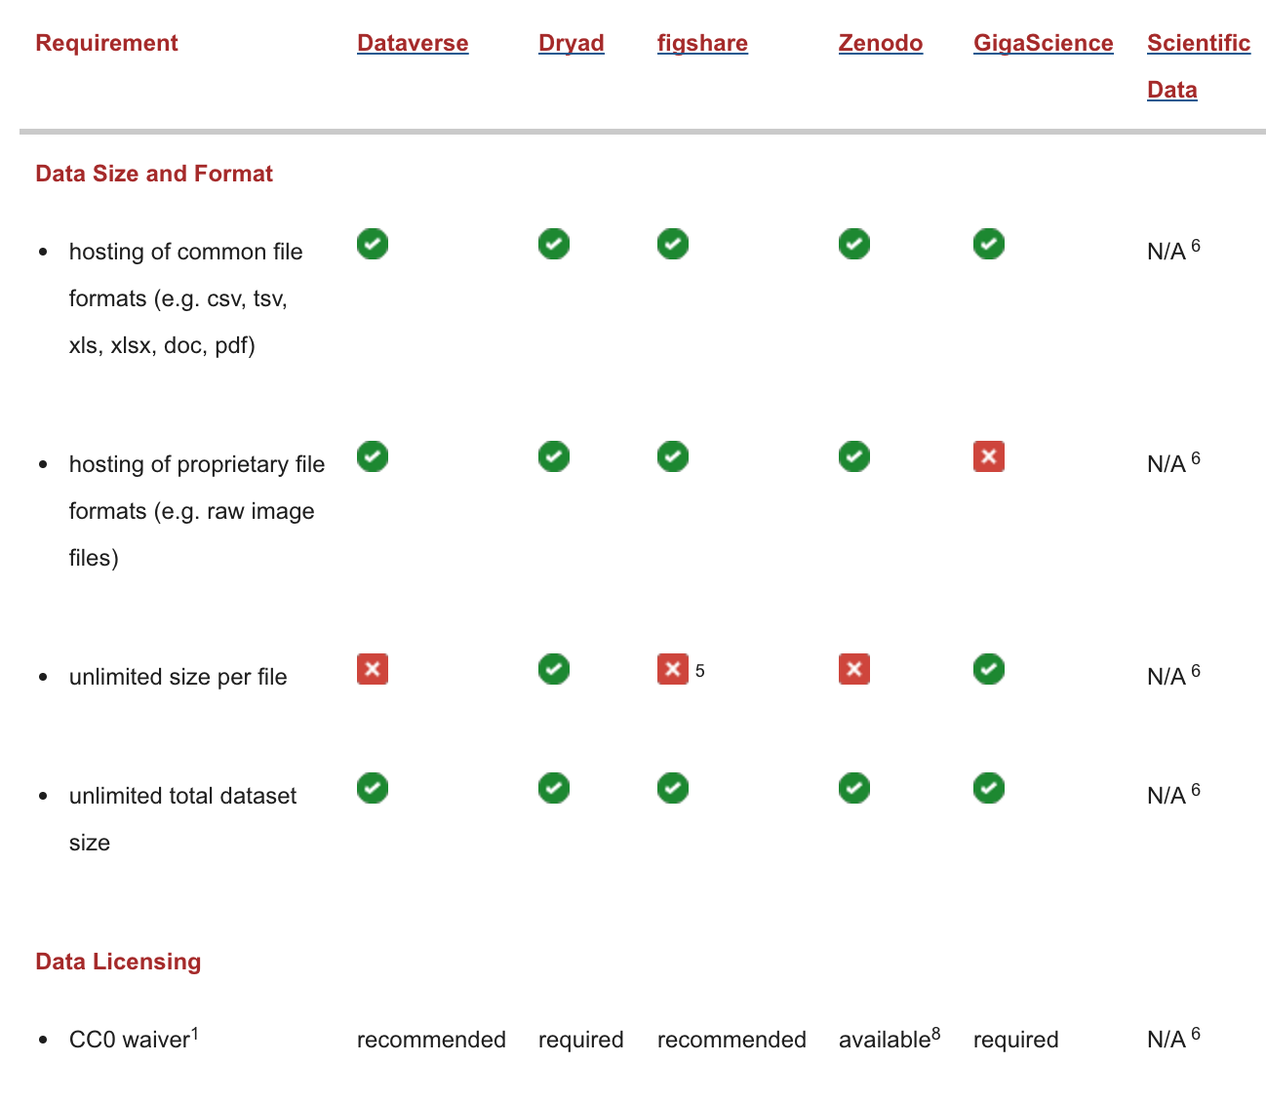
Data Repositories
Notes:
Data Repositories
The venue most suited for researchers seeking to share and maintain access to their data is the digital data repository.
There are three major types of digital data repositories.
1. Institutional repository (“IR”): connected to the researcher’s institution.
2. Disciplinary repository (“DR”): discipline specific and often operated by a professional organization, a consortium of researchers, or some similar group (e.g., Interuniversity Consortium for Political and Social Research (ICPSR).
3. Open Repository (“OR”): allows researchers from different disciplines to deposit and make their data available.
Three useful registries of repositories are Databib (databib.org), OpenDOAR (opendoar.org), and re3data (re3data.org). The re3data compares repository functionality. Databib and re3data are in the processing of merging with DataCite, an organization providing a mechanism to register and cite research datasets, so please note that these resources are growing and evolving .
Selecting a Repository
Access
As a researcher, you likely care a great deal about how others will be able to find, access, and use your work. Access-related features are critical considerations in deciding on a home for data. The act of discovery hinges upon proper indexing by search engines, and a common way that happens is through use of the OAI/PMH, the Open Archives Initiative Protocol for Metadata Harvesting.
Metadata matters
When a repository implements this protocol, then search engines (Bing, Google, etc.) will index the website, metadata XML documents, and resource identifiers. In addition, some repositories are developing notification services, which aim to alert researchers when new research articles (and the datasets generated as a product of the research described in those articles) are available on the web.
Permanent Identifiers
Another vital access characteristic for a data depositor is the assignment of permanent identifiers to the deposited files.
ORCID IDs for researchers work in much of the same way. ORCID provides a persistent digital identifier that distinguishes you from every other researcher and, through integration in key research workflows such as manuscript and grant submission, supports automated linkages between you and your professional activities ensuring that your work is recognized.
Embargoes
One of the fundamental tenets of the current movement to better manage federally funded research data is that data be openly accessible and free of restrictions. However, there may be valid reasons (intellectual property, national security, publication embargo, etc.) for limiting in some way or for some period of time, access to research data. Repositories can limit access to your data so that only you have access, or only people within your lab, or institution, etc. Please work with your library to choose an access level appropriate for your scholarship.
Licensing
Data user agreements (DUAs)/Data Sharing Agreements (DSAs) and licensing allow owners to state explicitly up front what uses they would be willing to allow. The most popular system for communicating these licenses is the Creative Commons (CC). Levels of CC licenses range from the most liberal “CC0,” which effectively renders material as public domain, to the most restrictive “CC BY-NC-ND,” which requires attribution, and disallows any changes as well as any commercial use. Some disciplinary repositories require a uniform level of licensing from their depositors. Please check with your library and intellectual property office to explore which license is right for your scholarship.
Standards
The status of certification and standardization for repositories is still in its early stages of development. The most widely known and yet the most exclusive centers around ISO Standard 16363, known as “TRAC Certification” (for Trusted Repository Audit and Certification, an earlier version of what has now been approved as an international standard.) There is a clear need for some common currency for recognizing quality and dependability, and it is something data depositors should bear in mind when choosing a repository.
Measuring Scholarly Impact
Finally, researchers should consider the extent to which they will be able to get back useful metrics for validating and expressing the quality, quantity, and impact of their work as distilled in the materials they have made available in a repository. Permanent Identifiers, such as the DOIs mentioned above, that can be assigned to data sets in a repository are also very useful for tracking citation and impact. Piwowar (2007) found that the papers most cited had publicly available, online, data sets. Thus, these identifiers can be fruitful for researchers’ promotion and tenure, as they can be used to collect metrics on the impact of their publicly available data sets and other scholarly output.
Depositing Data
Understanding the process of depositing data will be helpful once you have identified a repository for your research. Most repositories have some sort of mediated deposit workflow. However, as electronic research data repositories are increasingly called upon for data storage, a more automated, self-deposit system is likely on the horizon. In all cases, the researcher will need to identify and designate contacts for the material. In the self-deposit case, it will be necessary to create an account and log in to facilitate the deposit process.

Slide 21
Research Records
4 Types of Records
Destroyed
Active
Inactive
Archived
Notes:
MEGHAN
Understanding the types of research records you are working with is imperative for evaluating retention requirements.
Retention requirements may depend on a variety of factors, including the type of data, the purpose for which the data has been collected, and the policies of funding institutions or parent organizations.
Data retention refers to the length of time one needs to keep (or securely destroy) a project’s data according to the institutional (IRB), funder, state and/or federal guidelines.
From a legal and ethics perspective, researchers would want to know what the minimum years for retention would be and how long they would need to retain data documentation for any audits or misconduct investigations. For example, while the OHRP federal guideline (45 CFR 46) may mandate data be retained for a minimum of three years, many institutional policies require 5 years of retention, and many institutions require that research data records in support of shared patents with researchers be retained for the life of the patent.
According to Harvard University, University records are "all forms of recorded information regardless of physical characteristics, created, received, recorded, or legally filed in the course of University business or in the pursuance of the University's legal obligations." In other words, records comprise all documented activities carried out by University employees.
Harvard University records are the:
Documents and recorded information that you create during the course of your work
Records that are the evidence of the activities and transactions of your office
And this includes electronic records, such as research data.
This graph is a breakdown of the 4 types of records your department will encounter:
Records start off as active and when they become inactive – you are the left with two possible options:
Some inactive records might be eligible for destruction:
Grant financial records: 7 years from the date of grant closure
There are also other records that will never be eligible for destruction and can be transferred to the Archives:
These are the records that have long term value to support the work of the department, detail the work of faculty members, or contribute to scholarly research
Research data produced by labs is a case where the data might end up being destroyed or archived. University policy states that research data must first be evaluated by the Center’s Archives and Records Management program in order to determine whether or not it should be retained permanently.
Ethics and data
Any research institution (e.g. university, hospital, private research company, and soon) that accepts federal funding is required by law to have policies in place to oversee its research programs. These policies include monitoring conflicts of interest, reporting misconduct, and ensuring safety regulations are followed. They also establish standing committees to review human (Institutional Review Board) and animal (Institutional Animal Care and Use Committee) research protocols. (i.e.IRB and IACUC)

Slide 22
Retention
Data retention requirements are put in place by funding agencies and sponsoring institutions for a number of reasons:
the need to make research findings available for corroboration
to promote the reuse of data within and across disciplines
to support open data initiatives
the need to protect intellectual property rights
Evaluate for Retention
✓ Identify and retain essential research records
✓ Organize and annotate appropriately
Notes:
MEGHAN
Understanding Data Retention
Maintaining comprehensive and accurate research records and data is an important component of any research project and may be an obligation for the researcher long after a project has concluded. Data retention requirements are put in place by funding agencies and sponsoring institutions for a number of reasons, including the need to make research findings available for corroboration, to promote the reuse of data within and across disciplines, to support open data initiatives, and the need to protect intellectual property rights.
In order to comply with the terms of a grant, it is important to understand the retention requirements of those funding this research as well as the sponsoring organization. Furthermore, a parent organization may have specific retention requirements for research data, including an interest in permanently keeping some of these records as a part of its institutional history or intellectual property.
It is also worth noting that different retention requirements might apply to records related to data, such as the administrative or financial records of a research project. Not all funding agencies require the retention of these records, though they may be governed by records management policies at a parent institution. Researchers are responsible for understanding in advance the data retention expectations of their sponsors/funders and institutions so that they may plan their budget, future storage needs, and ongoing oversight of all records in their custody accordingly.
How Long to Retain Data
One of the most challenging aspects of data management is in understanding how long data needs to be maintained. Retention periods serve to help researchers understand how long they are required to keep their data in order to comply with the terms of their grant. Data retention requirements may be complex, and at times ambiguous, so it is important to understand the retention requirements of each of your projects’ sponsors, as well as storage requirements for special record types (e.g., tissue samples, laboratory notebooks, and proprietary databases, etc.), and policies and services of your parent institution. It is not a one-size-fits-all situation, and often there may be several different guidelines within one policy. It is also not unusual for several data retention policies to apply to one set of data, for example both a federal statute and an institutional policy may apply to a grant received by an academic department, and in this case, it is usually the longest amount of time recommended for retention that is applied. The reality is, however, that publishers also influence the retention of data; there have been publications that have retracted articles even after the standard six years because data called into question that could not then be found and substantiated,
A small percentage of data and related records might be identified for permanent storage as a part of the historical record of a discipline or institution, or as intellectual property. Records eligible for permanent retention may be those that:
document a breakthrough,
are generated by a lab or individual who had great impact on the field, or
are highly reusable in a particular area of research.
Permanent retention, or archiving, is often a significant investment for an institution, as it implies ongoing migration of electronic formats and storage costs, as well as care, maintenance and access services for the records in perpetuity. This is not the same as ensuring long-term storage or preservation of research data.
Adhere to your lab’s standard practices for data management and organization.
If you do not have standards, make them, write them down and follow them.
Keep your data for at least seven (7) years.
IP (Intellectual Property), human subjects information and other factors can influence (extend) retention timelines, so before you delete data, check with your lab and sponsor guidelines first. If you have IP, talk to the Office of Technology Department (OTD).
Store your data on University premises and/or systems.
If you are not sure what options are available to you, contact HUIT.
If you leave HMS, and would like a copy of your data, please discuss this with your PI. HMS must retain the original data in order to meet its obligations to sponsors and the federal government.
Remember: Harvard administration is here to help you organize and manage your materials. Stay in compliance and reduce administrative burden by calling HUIT or talking to your department administrator.
Qualities of a Preservation Repository
While a complete understanding of the technical requirements and information architecture necessary to certifying a repository a “preservation repository” is not required of researchers, detailed information about what digital preservation specialists look for can be found on the following websites:
Digital Repository Audit Method Based on Risk Assessment (DRAMBORA) : http://www.repositoryaudit.eu/about/
Lots of Copies Keep Stuff Safe (LOCKSS): http://www.lockss.org/
Network of Expertise in Long-Term Storage of Digital Resources (NESTOR): http://nestor.cms.hu- berlin.de/moinwiki/WG_Trusted_Repositories_-_Certification
Trusted Repository Audit Checklist (TRAC): http://www.crl.edu/archiving-preservation/digital-archives/metrics-assessing-and-certifying-0
These requirements include, but are not limited to:
Demonstrating commitment to the organizational infrastructure of the repository, such as maintaining “…a documented history of the changes to its operations, procedures, software, and hardware that, where appropriate, is linked to relevant preservation strategies and describes potential effects on preserving digital content.” (TRAC self-audit checklist section A3.6)
Policies relevant to digital object management, such as “documented processes for acquiring preservation metadata (i.e., PDI) for its associated Content Information and acquires preservation metadata in accordance with the documented processes. The repository must maintain viewable documentation on how the repository acquires and manages Preservation Description Information (PDI)” (TRAC self-audit checklist section B2.9) and “B5.3 Repository can demonstrate that referential integrity is created between all archived objects (i.e., AIPs) and associated descriptive information” (TRAC self-audit checklist section B5.3)
Policies relevant to technologies and technical infrastructure employed and data security, such as “a documented change management process that identifies changes to critical processes that potentially affect the repository’s ability to comply with its mandatory responsibilities” (TRAC self-audit checklist section C1.8)
An excellent overview is available on the Digital Curation Centre’s “Repository audit and assessment pages” (http://www.dcc.ac.uk/resources/repository-audit-and-assessment/repository-audit-and-assessment) as well as the “Ingest” section of the DC 101 training materials on the curation life cycle model (http://www.dcc.ac.uk/sites/default/files/documents/DC%20101%20Ingest.pdf).
Finally, repositories for the long-term management and preservation of data and associated records can be free, fee-based, or institutionally hosted (with or without cost to the researcher), and either open or closed to public access. While depositing to an open access repository is a necessity for government-sponsored research (and preferable from a knowledge-sharing and community building perspective), data can be preserved in closed access (commercial) storage services as long as the host institution is provided unfettered access to accounts. The benefits of commercial repositories over open access repositories and institutional repositories may include:
A higher level of system support
Tools that make deposits easier than open source tools
Higher levels of data security, such as for HIPAA-protected research data or other human subjects data and confidential information requiring a high-level of security
Insurance against data loss
Disadvantages may include:
Closed to reuse by the academic enterprise
Not citable or discoverable online
Lack of access or download metrics
Ongoing cost commitments on the part of the institution (e.g. storage fees, per-file download and upload service fees)
Opening accounts that may be known to only a few researchers and are at risk for abandonment
Time needed for vendor review/approval by your institution’s Chief Information Security Officer (if required)
Two examples of commercially available, secure online storage services are Amazon S3 storage (http://aws.amazon.com/s3/pricing/), which varies from .01-.085 per gigabyte a month and Arkivum (http://www.arkivum.com/), which ranges $587.02 (£360) - $733.77 (£450) annually with educational discount depending on the number of terabytes needed. Two examples of “free” repositories include The Dataverse Network (up to 1 terabyte free) and Dryad, which collects a one-time Data Publishing Charge (DPC) upon submission.
Fees associated with institutional repositories are generally storage, not service-based. While an institution’s archivist or records manager can help with the deposit of research data and records to an institution’s digital repository for free, a designated academic department usually pays the annual data storage fee. For fiscal year 2014, for example, Harvard University charged users of the Digital Repository Service $1.80 per gigabyte of storage.
Michigan State University Libraries. http://lib.msu.edu/rdmg/servcat/longterm/. Accessed 05 February 2014.
Zimmerman, A.S. (2008). New knowledge from old data: The role of standards in the sharing and reuse of ecological data. Science, Technology & Human Values, 33(5), pp. 631-652; Karasti, Helena and Karen S. Baker (2008). Digital Data Practices and the Long Term Ecological Research Program Growing Global. The International Journal of Digital Curation, 2(3), pp. 42-58
Harvard University. Office of the Vice Provost for Research. http://vpr.harvard.edu/pages/research-record-retention-and-management. Accessed 10 February 2014.
New York University. https://www.nyu.edu/about/policies-guidelines-compliance/policies-and-guidelines/retention-of-and-access-to-research-data.html. Accessed 10 February 2014.
http://www.dcc.ac.uk/sites/default/files/documents/DC%20101%20Ingest.pdf
Dickmann, Frank, Romanus Grütz, and Otto Reinhoff (2012). “A “meta”-perspective on “bit rot” of biomedical research data,” Quality of Life through Quality of Information, J. Mantas et al (Eds.). IOS Press.
Long-Term versus Permanent Retention of Data
Retention policies also serve to support an institution or archive in identifying those data and records that might be maintained permanently as a part of the historical record of a discipline or institution, or as intellectual property. Many institutions have an Archives or Special Collections unit whose mission is to collect, maintain, and provide access to records of enduring value for historical and research purposes, including research records and data. Records eligible for permanent retention may be those that document a breakthrough, were generated by a lab or individual who had great impact on the field, or are highly reusable in a particular area of research. Permanent retention, or archiving, is often a significant investment for an institution, as it implies ongoing migration of electronic formats and storage costs, as well as care, maintenance and access services for the records, often in perpetuity.
This is not the same as ensuring long-term storage or preservation of research data. Long-term storage and preservation seeks to ensure that research data will be available to those who seek it (e.g. your sponsors, the public, other researchers) in a persistent and accessible format for the specific period of time outlined by your funder and parent institution. These retention periods also allow for a measured period of time to pass so that a better assessment of the long-term impact of a research project can be evaluated, usually prior to or in conjunction with an archival appraisal process conducted by the Records Management or Archives or Special Collections department.
Data Disposal
While most research data and records retention policies maintain minimum requirements for keeping records, you are not required to keep your data for longer than the retention period specified by your institution or granting agency. Often the cost of long-term storage is prohibitive for researchers, and thus they may not be interested in storing and/or maintain data for any longer than necessary. Should your research data not meet criteria for permanent retention/archiving at an Archives or Special Collection, you may want to take steps to ensure that you have safely and completely disposed of your data once they have met their specified retention period.
Disposal of your research data might include shredding, deleting, disk-wiping, destroying, or otherwise disassembling any materials holding your data in a way that ensures that data cannot be reconstructed or extracted. You may feel that extra steps may be required to maintain safety, biologic or otherwise, and also the privacy and confidentiality of your research subjects if appropriate.
Always check with the policies of your institution or funder to make sure destruction actions are in line with their research records and data policies. Sometimes different policies may apply to research records, but not to data, so it is good to be confident of the policy before taking steps to destroy anything. Sometimes institutions may recommend that you document the records you destroy. A simple inventory of the records, their format, dates, and any relevant information about the grant or project along with reason for destruction (e.g. the retention period has been met, the data will not be archived), as well as destruction date and an authorizing signature if appropriate, will likely be sufficient record of your actions. Maintain this record along with any final outcomes of your project. The benefit of documenting the disposal of research data is multi-fold, including responsible management of the full life-cycle of your data, as well as avoiding future confusion about missing or abandoned data.

Slide 23
Appraisal & Archiving
Appraisal process for evaluating research records and data:
Inventory of the records: volume, data types, formats, metadata, other relevant information
Interview about the project: impact of the project, significance of the research or researcher, basic information about the grant
Long-term Storage & Archiving
✓ In compliance with HMS & federal policy
✓ As requested by investigators
Notes:
MEGHAN
Long-term storage and archiving can often be confused with one another.
LTS is the storage of the research records to meet the requirements of the granting agency or the institution
HMS IT offers a Long-Term Storage service
For storing large quantities of infrequently accessed data that do not need to be retrieved immediately
Ideal for: Completed or published projects
For more information about the service, please visit: http://rits.hms.harvard.edu/dm/lts
Send questions to the Research Data Manager: rdm@hms.harvard.edu
Which data sets are worthy of permanent retention/archiving? Which data sets should be disposed of once their retention period has been met? What criteria are used? Who decides?
Appraisal
In order to identify research data that will be permanently maintained by an institution or archive, many organizations or Archives will have an appraisal process for evaluating research records and data. This will often involve an inventory of the records, including volume, data types, formats, metadata, and other relevant information, as well as an interview about the project, including questions about the impact of the project, significance of the research or researcher, and basic information about the grant.
Common questions to anticipate include:
What are the essential records required to understand this research data and project?
What was the impact of this research on its discipline?
What had been the impact of the researcher in their field?
Are the data replicable?
Is there an index to the data? How would future researchers understand the research?
Has this research been published? Where?
Has the data been kept in a research repository?
Are there additional records related to the data?
Are there security or access issues?
Does someone else own the data?
Related Records
Some questions during an appraisal process serve to highlight records related to the research data that may provide context to the data or project overall. These records, and their connection to the research data, are a key element in considering a collection of research data for permanent retention in an archive. They help someone unfamiliar with the details of the research make sense of the overall project’s mission, progress, and findings. Additionally, these records may have different retention periods than the research data, so it is important to recognize these records as separate, yet closely related to, your data and requiring management and oversight. In some cases institutional policies may specify that these records are required to be archived, perhaps for historical purposes, even if the data is not.
Examples of related records include:
Human or animal subject protection records including proposals, protocols, informed consent forms, laboratory care documentation, and related correspondence.
Administrative records such as proposals, working papers, meeting minutes and notes, narrative reports, internal status reports, personnel records, deliverables such as books and manuals, project review summaries and reports, and related correspondence.
Financial records such as accounts payable, invoices, and budget monitoring or audit records.
What Data Should Be Archived?
Research data and records acquired by an Archives or Special Collection are often assessed to be of long-term, enduring value to a scientific discipline, the public interest, or institutional legacy. Data sets are often considered a priority for inclusion in an archive when:
The data is not available anywhere else, or is not likely to be available elsewhere in the future
The research is in line with the collecting policies of an institution
Related records are well maintained, comprehensive and available for archiving
Ownership is clear
Standards for privacy and confidentiality of subjects studied are clear
The technical documentation is comprehensive
The data is in a format that facilitates ease of use and preservation

Slide 24
Questions?
http://datamanagement.hms.harvard.edu
Notes:
I encourage everyone to bookmark the site and reference as needed
The site will continue to be updated so I encourage you to revisit periodically
You can also submit your questions and feedback here.

Slide 25
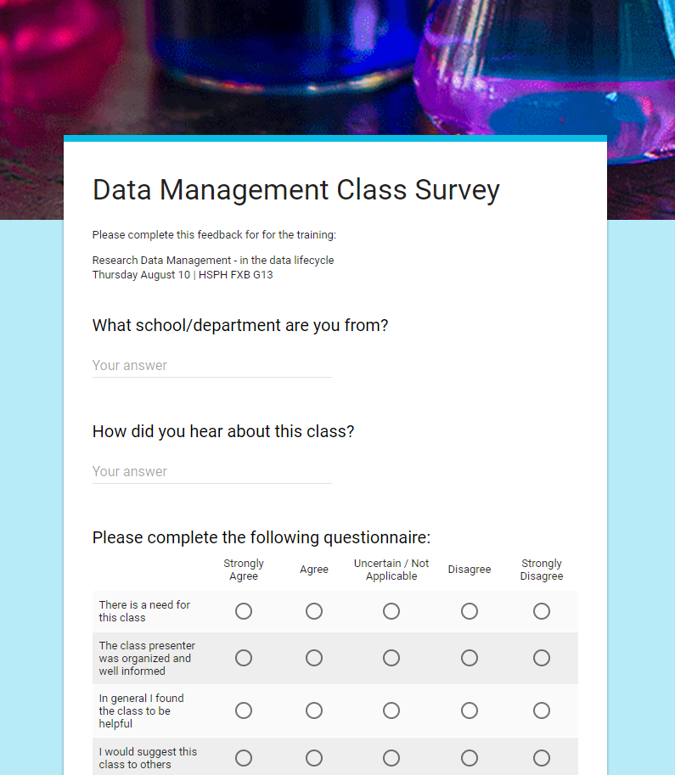
http://bit.ly/rdm-survey

Slide 26
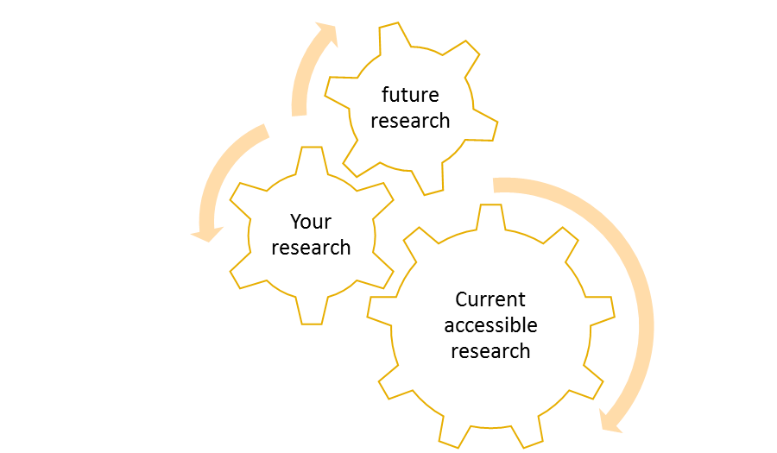
Key Resources
Harvard Biomedical Data Management http://datamanagement.hms.harvard.edu
Center for the History of Medicine | Archives and Records Management https://www.countway.harvard.edu/chom/archives-and-records-management
Research Information Technology Solutions http://rits.hms.harvard.edu
Office of the Vice Provost for Research | Research Data Security & Management https://vpr.harvard.edu/pages/research-data-security-and-management
Harvard Catalyst | The Harvard Clinical and Translational Science Center http://catalyst.harvard.edu
Office for Scholarly Communications https://osc.hul.harvard.edu/policies

Slide 27
References
Data Management. University of Pittsburgh. http://www.edc.pitt.edu/about/data-management
Study Design. University of Ottawa Faculty of Medicine. https://www.med.uottawa.ca/sim/data/Study_Designs_e.htm
New England Collaborative Data Management Curriculum. Lamar Soutter Library, University of Massachusetts Medical School. http://library.umassmed.edu/necdmc
DCC. (2013). Checklist for a Data Management Plan. v.4.0. Edinburgh: Digital Curation Centre. http://www.dcc.ac.uk/resources/data-management-plans

